Slide 1
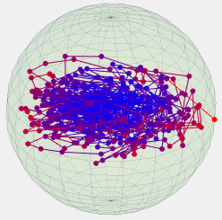
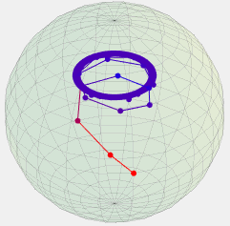
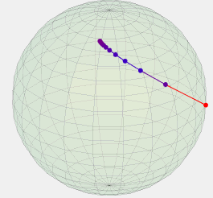
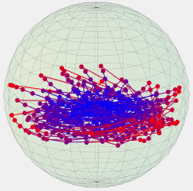
Ergodic Quantum
Processes
Random Independent and Identically Distributed
Channels
Markov Chain of Channels
Quasiperiodic Sequence of Channels
Repetition of a Single Channel
(Time Translation Invariance)

